Slide 1

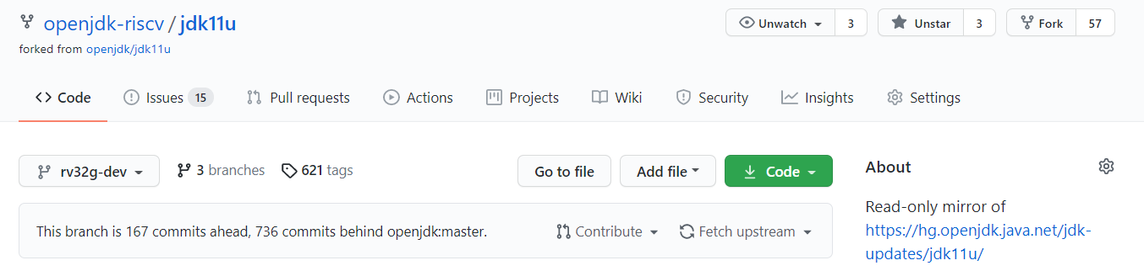

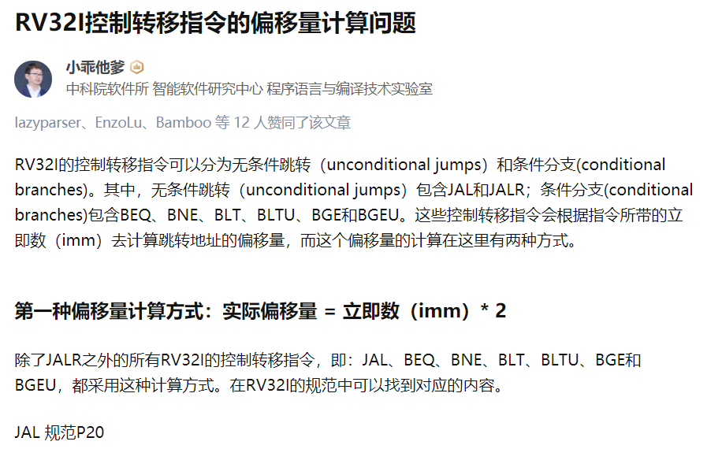
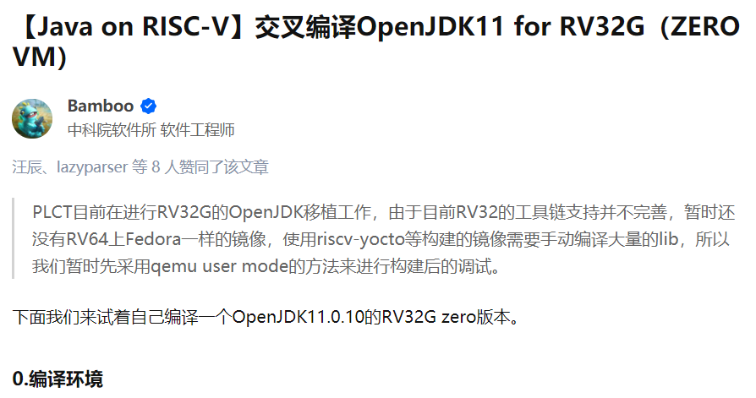
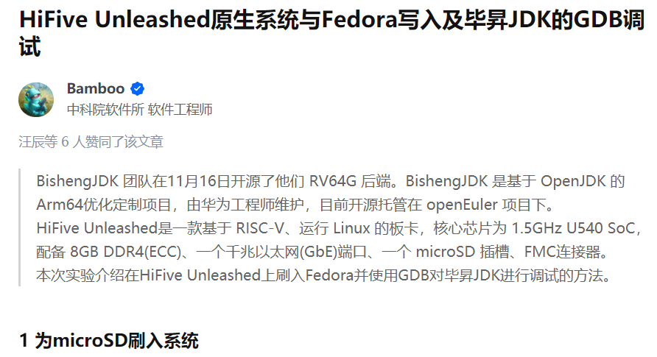

The Introduction of Porting OpenJDK to RV32G
PLCT Lab
OpenJDK is the most popular Java program interpreter. BishengJDK supports RV64G. We are porting the OpenJDK to RV32G.
This project began in January 2021. We have three team members working on it.
We chose OpenJDK 11.0.9-ga as the base code.
We implement the RV32G code according the RV64G code in BishengJDK.
The project is open source on github, ULR is: https://github.com/openjdk-riscv/jdk11u
We also wrote some docs about the OpenJDK 11 and RISC-V, they are collected on the page: https://github.com/openjdk-riscv/jdk11u/wiki
If you are interested, please contact us:
shiningning@iscas.ac.cn
dingli@iscas.ac.cn

